Slide 1

probable purchase
A Deep Dive into Customer Purchase Predictions
by : Divya Sapkal
To : Irfan Sir

Slide 2

INdex
INTRODUCTION
OBJECTIVE
MOTIVATION
PROCESS FLOW & MODEL MAKERS
DATA DESCRIPTION
MANIPULATION OF DATA
GRAPHICAL REPRESNTATION
MODEL BUILDING
CLASSIFICATION REPORT
COMPARATIVE ANALYSIS OF MODEL PERFORMANCE
CONCLUSION

Slide 3
introduction
Welcome to our presentation on predicting customers' probable purchases! In today's competitive market landscape, understanding customer behavior is paramount for businesses to thrive. The ability to anticipate what customers might purchase next can significantly impact sales, marketing strategies, and overall business success.
In this presentation, we'll delve into the fascinating world of predictive analytics. Predictive customer analytics refers to the process of analyzing your customers' past behavior and predicting their actions in the future. It involves using historical data, statistical algorithms, and machine-learning.
Key Points:
The importance of understanding customer behavior in today's market.
Introduction to predictive analytics and its relevance in predicting customer purchases.

Slide 4
objective Motivation
Enhancing Customer Experience
Optimizing Marketing Strategies
Improving Inventory Management
Increasing Sales and Revenue
Staying Competitive
The objective is to build a machine learning model that predicts whether customers will make their next purchase within a specified period (in this case, 90 days from their last purchase). This prediction will assist the managerial team of an online retail shop in identifying which customers to focus on for upcoming promotional offers. By leveraging predictive analytics, the team can allocate resources more effectively and tailor marketing strategies to target customers who are more likely to make a purchase, thereby maximizing the impact of their promotional efforts.

Slide 5











PROCESS FLOW
Data Preprocessing
Exploratory Data Analysis (EDA)
History of Customer Purchases
Model Building
Conclusion
model makers
Python – Jupyter Notebook
Libraries -- Numpy, Pandas, matplotlib,
seaborn, Scikit-learn

Slide 6
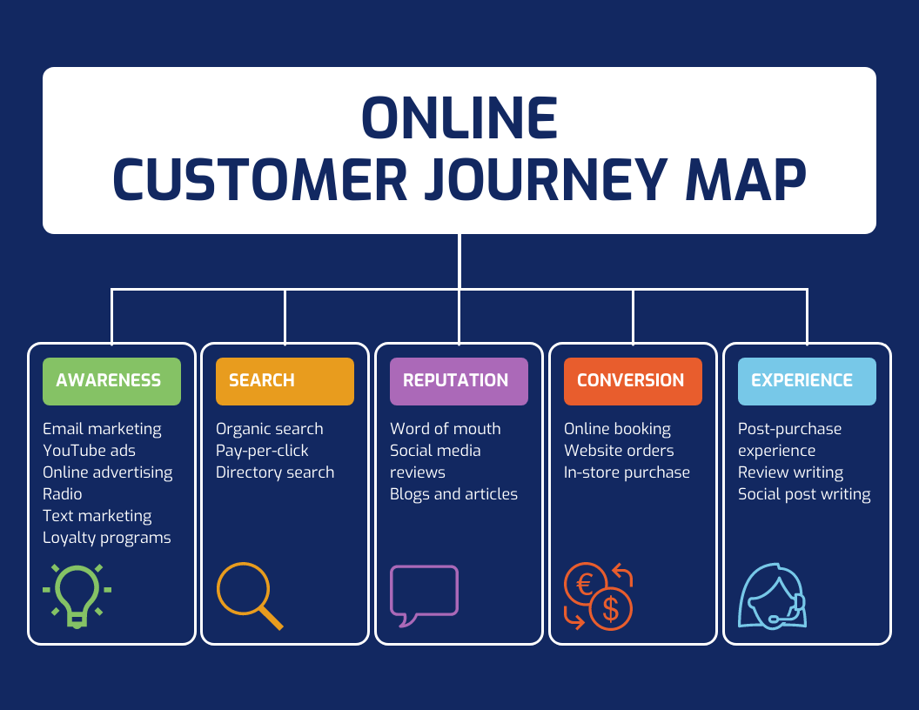
Data Description
Source:
(www.kaggle.com)
Customer Journey
Invoice: Unique identifier for each transaction.
StockCode: Code representing the product in the transaction.
Description: Description of the product.(practical household items and whimsical decorative pieces)
Quantity: Number of items purchased in the transaction.
InvoiceDate: Date and time of the transaction.
Price: Price of each item in the transaction.
Customer ID: Unique identifier for each customer.
Country: Country where the transaction took place.

Slide 7
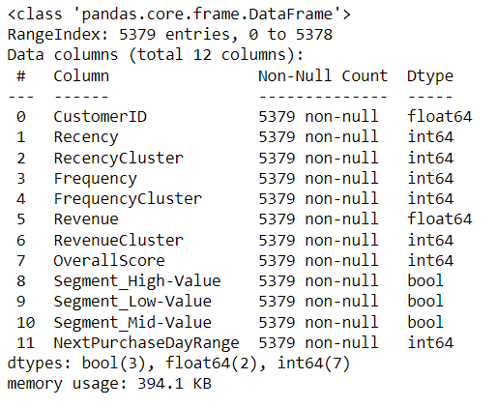
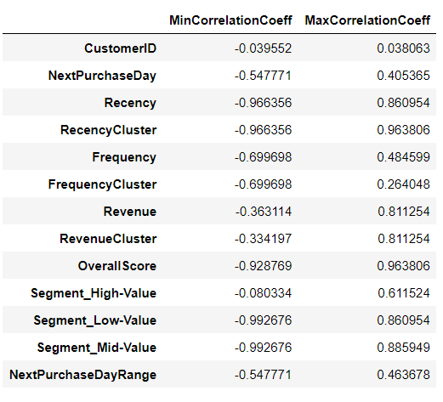
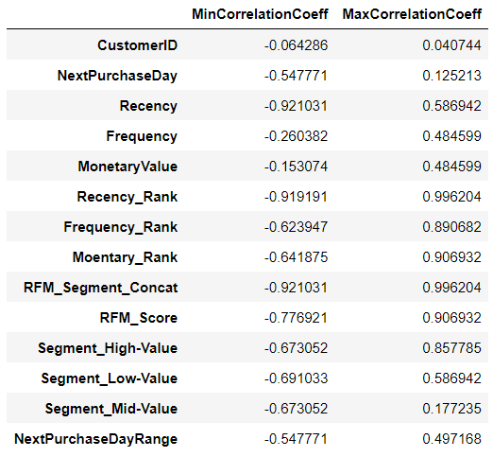
There are 5379 rows and 12 columns with integer, float and bool datatypes. “ NextpurchaseDayRange " is dependent variable.
we observe that Recency_Rank has the highest positive correlation of 0.996 with RFM_Segment_Concat, and Recency has the highest negative correlation of -0.921 with RFM_Segment_Concat.

Slide 8
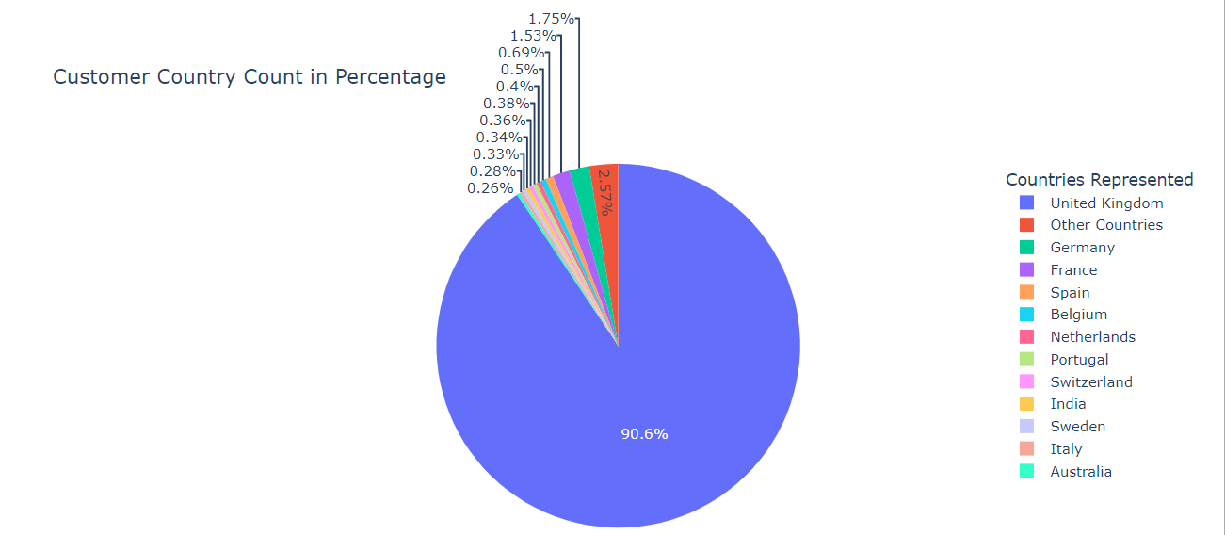
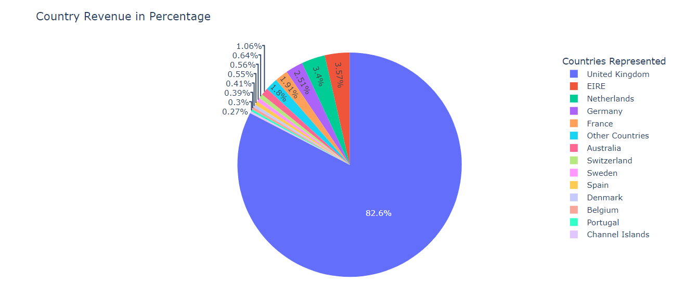
GRAPHICAL REPRESNTATION
Customer Country Count
Country Revenue
From below outcome, shows the countries of that max customers/purchase from the online retail shop:
The United Kingdom
Germany
France
Spain
Belgium
with the United Kingdom being the country with the highest customers. They represent about 90.6% of the entire online customers.
From below outcome, shows the top countries with respect to revenue generated are:
The United Kingdom
The Republic of Ireland (EIRE)
The Netherlands
Germany
France
with the United Kingdom recording the highest in percentage 82.6%

Slide 9
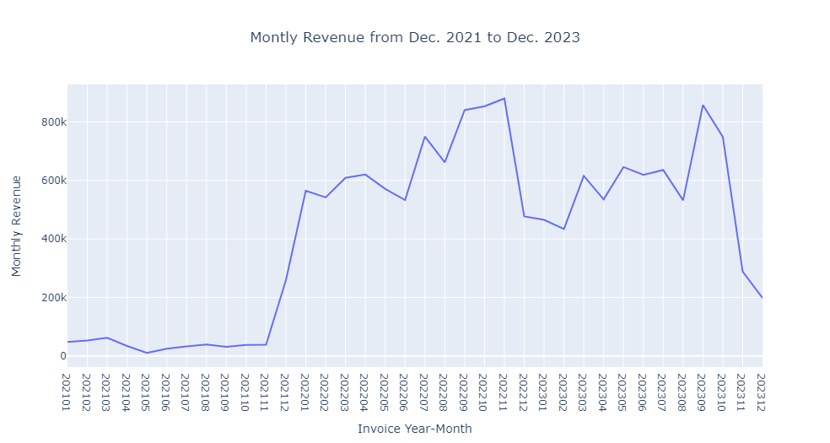
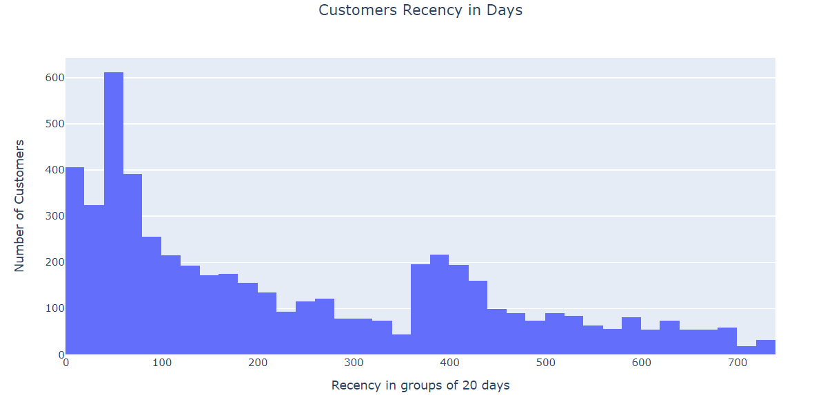
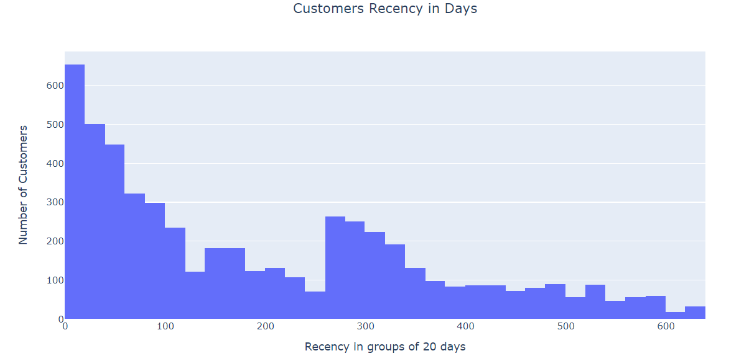
Montly Revenue from Dec. 2021 to Dec. 2023
From the graph figure, we observe that the online retail shop made the highest sales in November 2022, followed by November 2023. Also, one can observe that, monthly sales rises after August.
Customers Recency in Days
Recency: Customers purchase behaviour based on their most recent purchase date and how many days they have been inactive since their last purchase.

Slide 10
The dataframe is split into two:
Extract First Purchase in Next Quarter &
Extract Last Purchase in Historical Data
create a new column NextPurchaseDayRange with values as either 1 or 0
Calculate Time Difference Between Last Purchase
and First Purchase in Next Quarter
Create dummy variables for the 'Segment' column into low-value, Mid-Value,high-value
Manipulation of Data
Monetary Value/Revenue: Customers purchase behaviour based the revenue they generate.
Calculate Recency - Frequency - Monetary by RFM Model
Frequency: Customers purchase behaviour based on the number of times they buy from the online retail shop.
Recency : most recent purchase date of each customer and see how many days they have been inactive.

Slide 11
LOGISTIC REGRESSION
DESICION TREe CLASSIFIER
RANDOM FOREST CLASSIFIER
Model Building

Slide 12
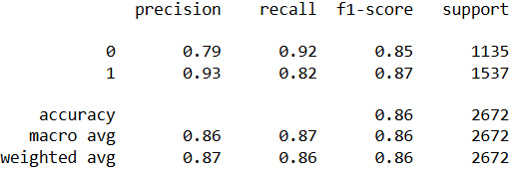
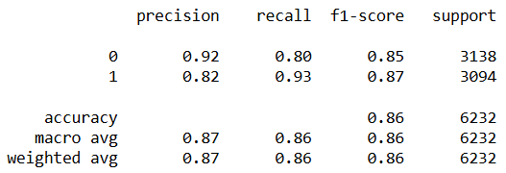
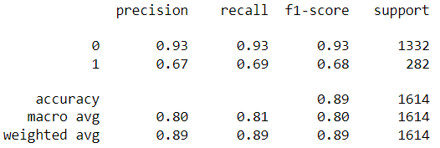
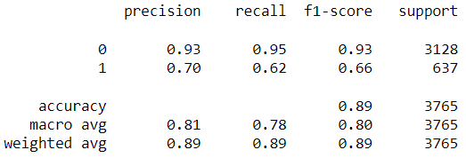
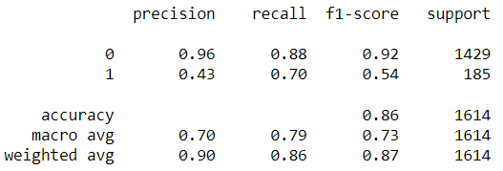
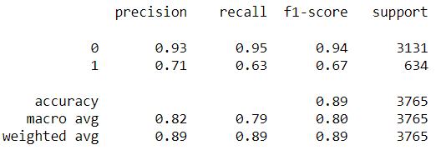
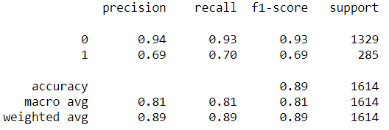
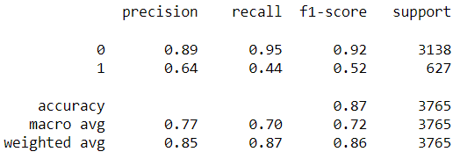
LOGISTIC REGRESSION
Confusion matrix for train data
Confusion matrix for test data
Test Accuracy : 86%
Specificity: 92%
Sensitivity: 82%
Train Accuracy: 86%
Specificity: 80%
Sensitivity: 93%
Model is Good fit

Slide 13
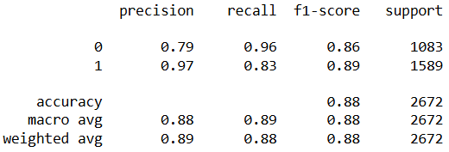
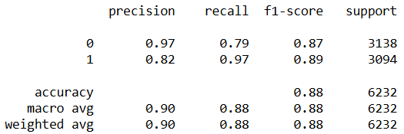
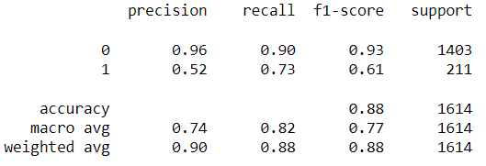
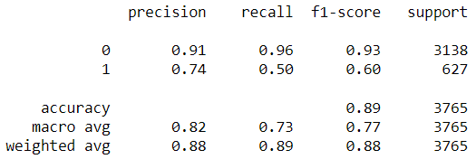
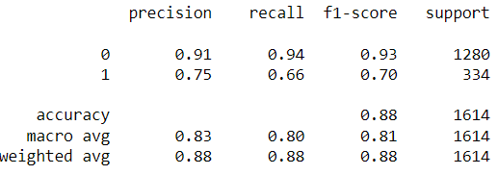
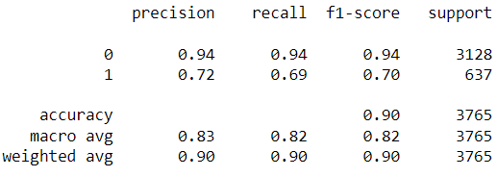

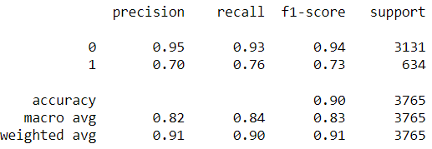
DESICION TREE CLASSIFIER
Confusion matrix for train data
Confusion matrix for test data
Train Accuracy: 88%
Specificity: 79%
Sensitivity: 97%
Test Accuracy: 88%
Specificity: 86%
Sensitivity: 89%
Model is Good fit

Slide 14
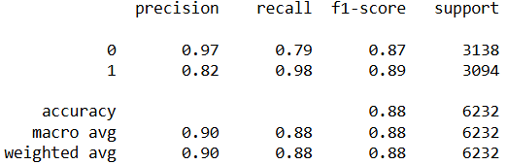
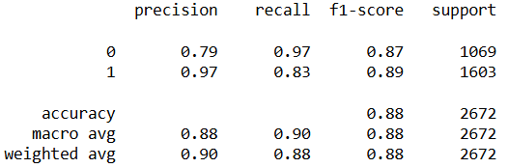
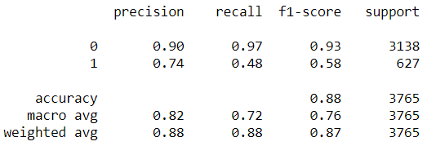
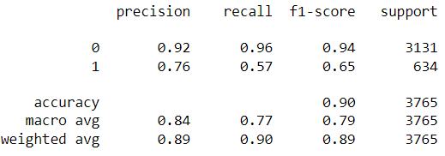
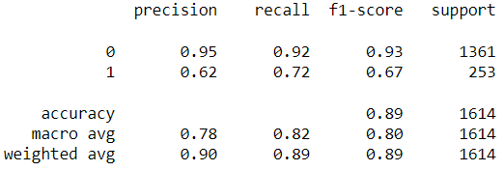
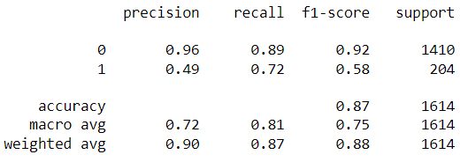
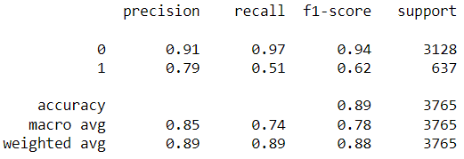
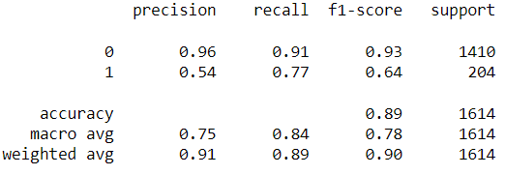
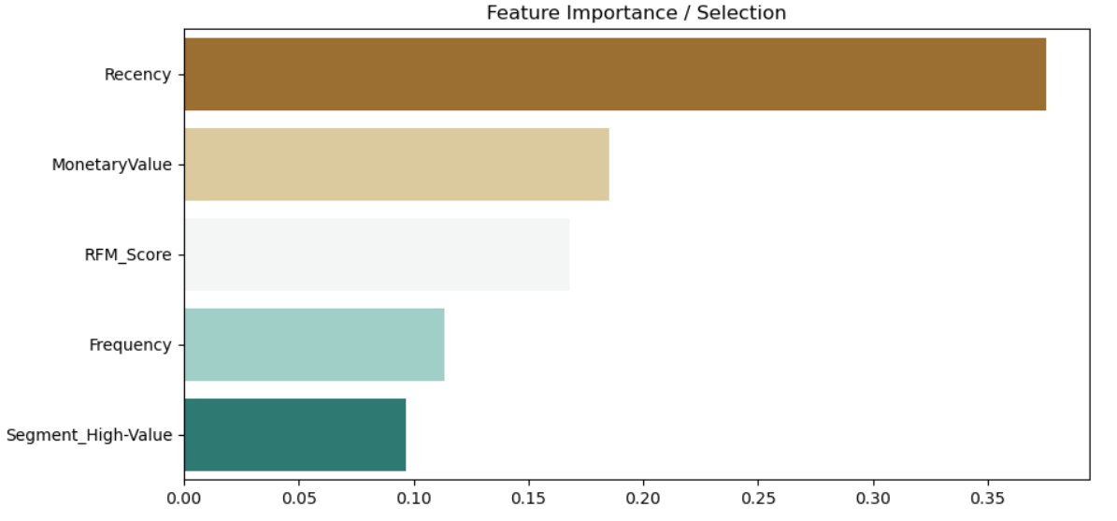
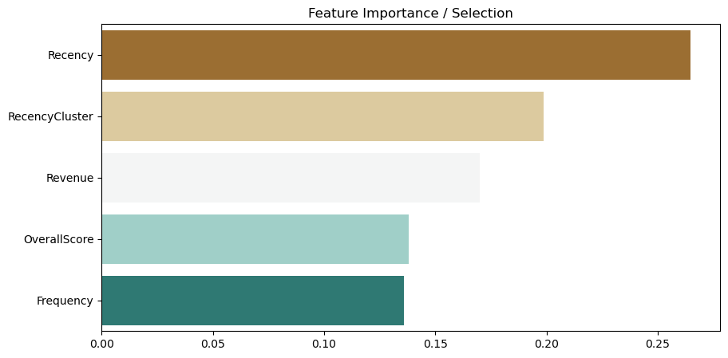
Random forest classifier
Confusion matrix for train data
Confusion matrix for test data
Train Accuracy: 88%
Specificity: 79%
Sensitivity: 98%
Test Accuracy: 88%
Specificity: 97%
Sensitivity: 83%
Model is Good fit

Slide 15
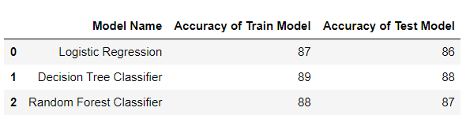
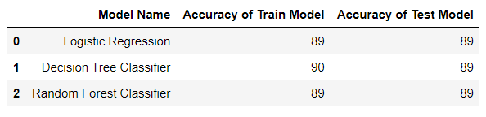
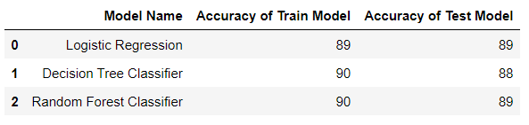
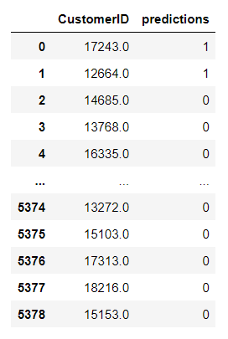
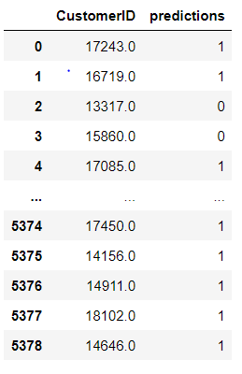
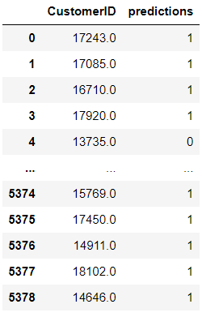
Comparative Analysis of Model Performance
After evaluating logistic regression, decision tree, and random forest models for predicting customer probable purchases, the decision tree model emerges as the optimal choices by output(accuracy) i.e. 89% from his or her last purchase. And Accuracy of Test Model is 88%. So we select decision tree for prediction whether customer is purchasing within 90 days.
Predictions using customerid's on Random Forest
If the value is 1, then it indicates that the customer will buy something in the next quarter, i.e., 90 days from his or her last purchase.
The value 0 indicates that the customer will buy something in more than 90 days from his or her last purchase.

Slide 16
Conclusion
Predicting customer purchases within the next 90 days using a Decision Tree model enables businesses to take proactive steps to optimize marketing efforts, improve customer satisfaction, and drive long-term growth. By leveraging data-driven insights, businesses can better understand customer behavior and tailor their strategies to meet the needs of individual customers, ultimately leading to increased revenue and profitability.

Slide 17
THANK YOU !

